Slide 1


LEF Quality Assurance Tool
ECE Department
EE/CPE584 Introduction VLSI
Abrahim Hamdan
Ash Huang
Benjamin Perry

Slide 2
Background
Layout View
Abstract View
LEF (Library Exchange Format) file
Contains abstract layout views of the cells in an IC
Used by P&R tools to route cells properly.
Inverter Example --->
TLEF (Technology LEF) Files
Contains layer definitions, via definitions, and design rules.
Provides layer types and manufacturing constraints.
Liberty (LIB) Files
Contain timing and electrical info associated with standard library cells.
Used by timing and power analysis tools to verify circuit performance.
I/O Pins
Obstructions

Slide 3
Background – LEF Files Hierarchy
LEF Format Version
VERSION
BUSBITCHAR
DIVIDERCHAR
MACRO 1
- CLASS / SIZE / SYMMETRY
- PIN Statements
- OBS
MACRO 2
MACRO 3
⋮
MACRO N
END LIBRARY
Bus Bit indexing “[]”
Hierarchy separation “/”
Cell Definition
I/O Pins with direction,
use, and port geometry
Defines the cell properties
and dimensions
Obstruction layers
with geometries

Slide 4
Background – TLEF Hierarchy
VERSION
BUSBITCHAR
DIVIDERCHAR
UNITS
SITE
LAYER
MASTERSLICE
PWELL, NWELL
IMPLANT
VTL_N/P, VTH_N/P
CUT
CO, VIA1-VIA8
ROUTING
MET1-MET8
VIARULE
LEF Format Version
Bus Bit indexing “[]”
Hierarchy separation “/”
Units of measurements
Defines placement grid for
Std cells.
Base layers for transistors
Defines Threshold
Voltage
Vertical connections
Between metal layers
Horizontal metal
interconnects
Automatic generated
Via array

Slide 5
Background – LIB Hierarchy
Library Name & Units
Operating Conditions
Cell 1
- Area / Leakage Power
- pin (input)
- Capacitance
- Timing (setup/hold)
- pin (output)
- Function
- Timing (delays, transitions)
- Power (rise/fall power)
Cell 2
Cell 3
⋮
cell N
Defines the library
and measurement units
Defines the process,
voltage, and temp the
the library was characterized
Cell Properties: Physical size
Power consumption when idle
Input Pin Definition
For sequential cells
Output Pin Definition
Boolean Equation
of the output
How fast the
output switched
Dynamic power
consumed

Slide 6
Provided Script
Quality assurance tool that validates LEF cell library files against Liberty and technology files for DRC compliance.
The provided script can:
Parses and sorts LEF files: Reads LEF files and sorts cells, pins, and properties in a consistent order.
Cross-checks LEF against LIB files: Compares cells and pins between LEF and Liberty files to find mismatch cells and pins.
Validates LEF file syntax and completeness: Checks to see if the direction for pin properties matches

Slide 7
Script Command Lines
To run the script:
./lef_QA.rb -w <workspace_dir> # Specify working directory
./lef_QA.rb -t <tech.tlef> # Specify technology LEF
./lef_QA.rb -l <liberty_dir> # Specify liberty file directory
./lef_QA.rb -s <file.lef> # Only sort LEF file
./lef_QA.rb -i <file.lef> # Skips printing large errors (>1000)
./lef_QA.rb –h # Outputs the help manu
Cannot run –w with –s.
Can run –s with –l and –t. For example:
./lef_QA.rb -s <file.lef> -l <liberty_dir> -t <tech.tlef>

Slide 8
Script Output
After executing the script, it outputs three files:
Sorted LEF file (*_sorted)
Rewrites the LEF file with cells sorted alphabetically.
Orders cell properties consistently (CLASS, ORIGIN, SIZE, etc.).
Sorts pins alphabetically within each cell.
Error Report file (*_errors)
Lists missing required properties.
Reports mismatches between LEF and Liberty files.
Flags syntax issues.
Comments file (*_comments)
Extracts all comments lines from LEF file.

Slide 9
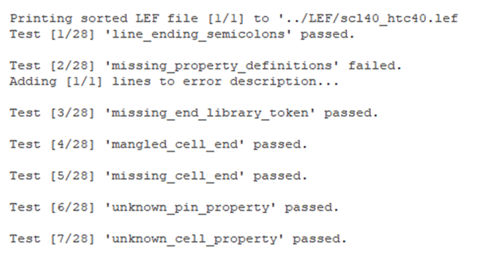
Script Output
The script also outputs all different types of tests to validate LEF properties, LEF syntax, and mismatches between LEF and LIB.
Test Number
Test Name
Indicates if test passed or failed

Slide 10
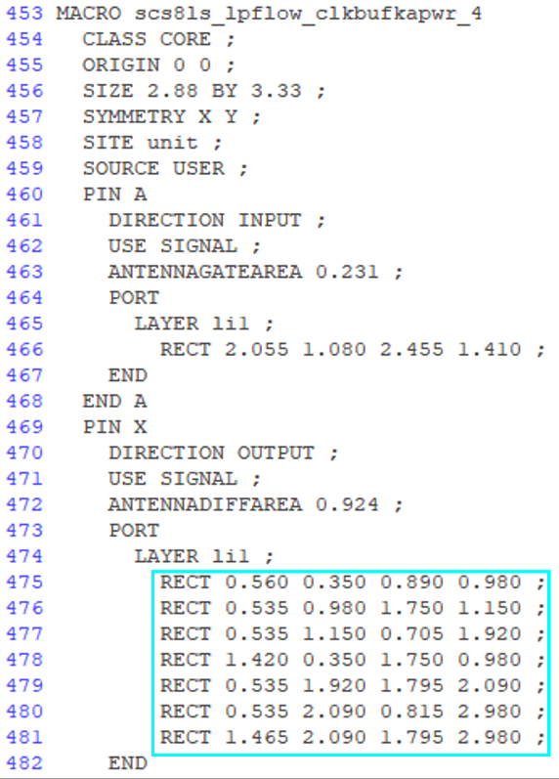
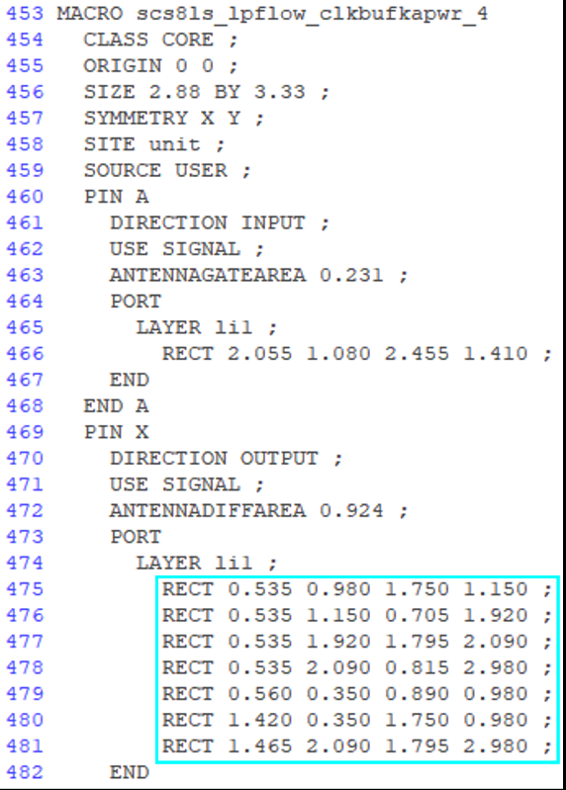
Script Output – Sorted LEF File
Original LEF:
After Sorting:
Not sorted
Sorted
12/19/2025
EE/CPE584 Intro to VLSI
10

Slide 11
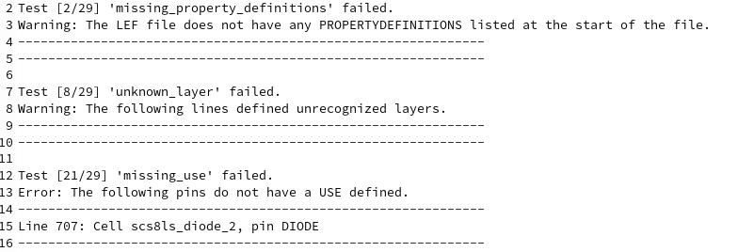
Script Output – Error LEF File
Test Number
Test Name
Warning or error output
Line number for error
Cell name for error
Pin name for error
12/19/2025
EE/CPE584 Intro to VLSI
11
Notes:
Bobby

Slide 12
Script Flowchart Part 1
Parses LEF file
For each Macro
Extract properties
For each pin
Extract direction, use and port.
Extract OBS
Start
Parse Command Line Argument
Scan for LEF and TLEF files
Sort LEF using cells, pins, properties
Parses TLEF
to get layers
Next slide

Slide 13
Script Flowchart Part 2
Previous Slide
Validate LEF File for:
For any missing properties
Unknown Layers
Syntax Errors
LIB file provided?
No
Yes
Parse LIB file
Extract cells, pins, area, and direction.
Generate Output Files:
Sorted LEF file
Error Report
Comments file
Compare LEF with LIB
Cells exists in both?
Pins exists in both?
Area matches the Size?
Pin direction matches?
End

Slide 14
Problem Statement
LEF-LIB Data Consistency
No comprehensive comparison between physical layout (LEF) and logical timing (LIB) files.
VIA Layer Validation Gap
No validation to ensure VIAs in cell pins have corresponding OBS layers.
Code Maintainability Issues
Poor code readability makes maintenance, debugging, and enhancement difficult.

Slide 15
LEF-LIB Compare

Slide 16
Previous Script Outline
Previous LEF-LIB Comparison Script:
compared cell dimensions (LEF SIZE vs LIB area properties)
verifies pin exist in both files.
Issues:
Limited Scope: Only checks geometric properties and pin existence, missing pin verification.
Lack of communication to users: Does not inform user of what is causing the errors
Pin existence incorrect
reports ground and power pins missing despite being in both LEF and LIB files

Slide 17
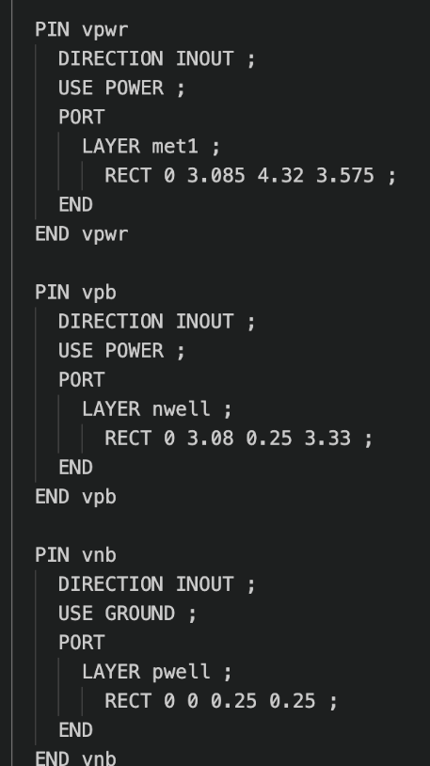
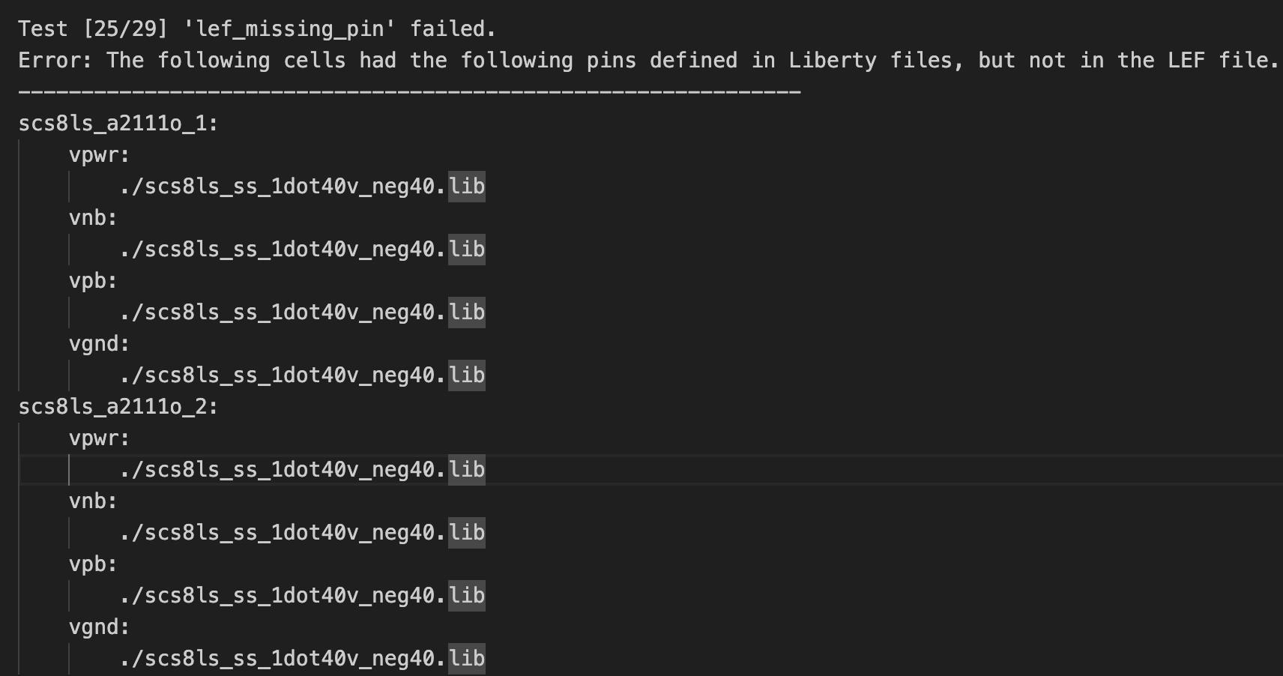
Previous Script’s Error file showing Pins Missing Errors
Cell a21110_1 pins in Lef
Output of Errors File
Cell Name
Pins “missing”
Previous implementation Issue:
Say that Lef is missing all ground and power pins despite being defined in both Lef and lib
Notes:
Define what the error is , what caused it before and how i fixed it up. Highlight the errors

Slide 18
Cause of Issue for the Pin Missing Errors
Start
Lef Files Processing
Lib Files Processing
*Error:
Lower case pg_pins in lib are compared to upper case pins in lef, causing errors to be thrown out and the program to identify pins to be missing from one file
Lef_pins= Lef_Pins. Upcase();
Output Lib_pins = Lib_pins.Upcase;
Output Lib_pins = pg_pins;
Does Lef_pins == Lib_pins?*

Slide 19
Solution to Issue for Pins Missing Errors
Start
Lef Files Processing
Lib Files Processing
*Solution:
Make all parsed pins uppercase to prevent case sensitivity issues
Output Lef_pins= Lef_Pins. Upcase();
Output Lib_pins = Lib_pins.Upcase;
Does Lef_pins == Lib_pins?*

Slide 20
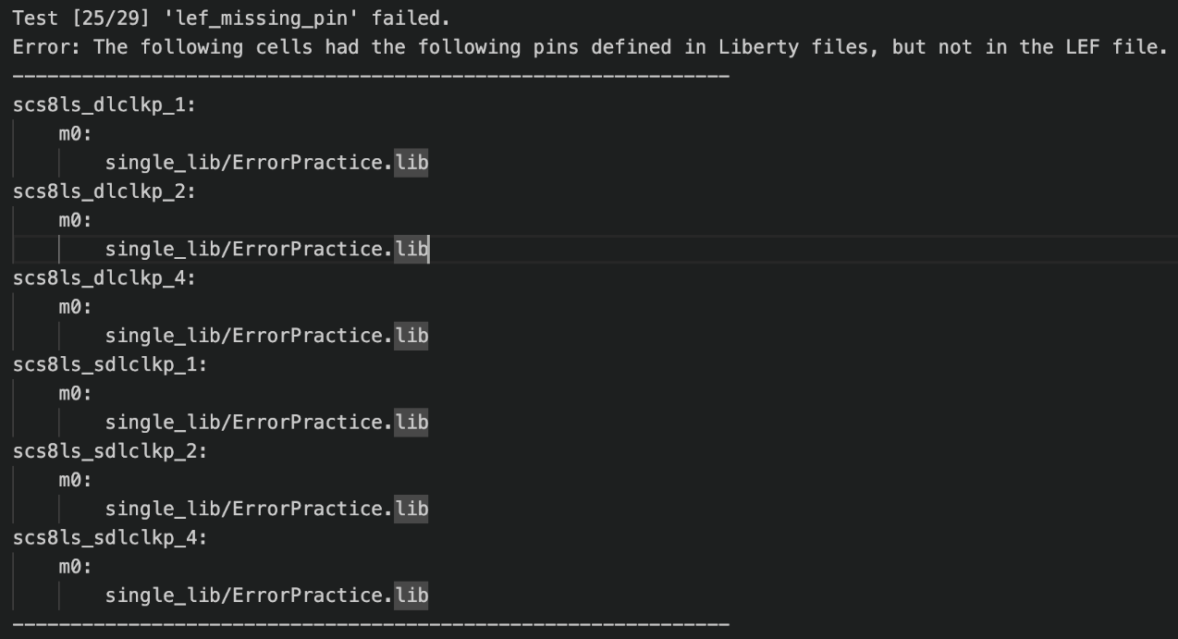
Updated Script’s Error File after uppercase correction
Only shows pins that are truly in one file and not the other
Provides the cell name, pin name and the lib file they are not in
Cell of missing pin
Missing Pin name
Liberty file of missing pin

Slide 21
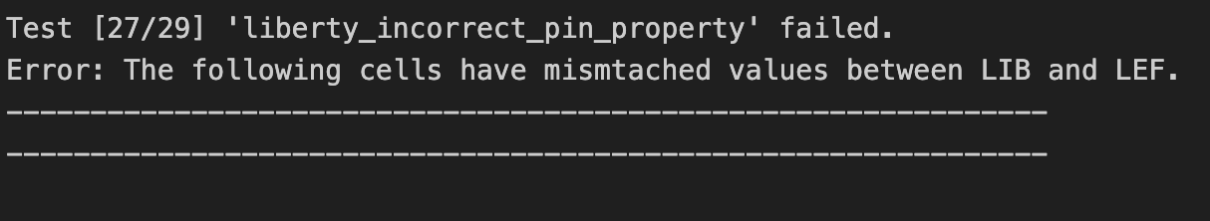
Previous Script Showed a lack of detail on why the liberty incorrect pin property failed
Output of Errors File
Script tells that there are cell properties missing in both scripts but does not display:
Which cell
What properties
What caused the mismatch/fail

Slide 22
Initial Implementations for Property Comparison
Start
Issues:
*Only Directions is compared despite having a loop going through all properties
**Value of each property must match exactly (ex. Input = Input) leaving limited comparison between two files
***Returns fail but does not imply or explain what caused fail
Input Lib_pin;
Input Lef_pin;
Input Lib_pin_property;
Input Lef_pin_property;
Yes;
Next pin
*Lib_pin == Lef_pin?
***Output failed;
No
**Lib_pin_property == Lef_pin_property?
No

Slide 23
New Implementations
The new script current supports comparisons for
Cells:
Area - Ensures Area from LIB files matches the Areas from LEF files
Pins:
Direction – ensures directions from both LIB and LEF matches
Clock – Verifies LIB clock pin aligns with LEF “USE” property
PG_Type – Verifies LIB power or ground pins aligns with “USE” properties
Voltage_Name – ensures the voltage name in LIB is consistent
Related_Power_Pin / Related_Ground_Pins – validates References between power and ground properties between pins in the LIB file.

Slide 24
New Implementation Flowchart
Start
Output Error;
Case Comparison_Type
False
Voltage_Name
Voltage_name == pin name?
True
End
Next Slide

Slide 25
New Implementation Flowchart
Previous Slide
True
Related_Power
Related_Power == VPWR || VPB
False
Output Error;
End
Related_Ground
Related_Ground == VPWR || VPB
False
True
Next Slide

Slide 26
New Implementation Flowchart
Previous Slide
True
Lef_Direction == Lib_Direction
Direction
End
False
Output Error;
Next Slide

Slide 27
New Implementation Flowchart
Previous Slide
LEF_USE == CLOCK;
LIB_CLOCK == TRUE;
LEF_USE != CLOCK;
LIB_CLOCK == FALSE;
Clock
End
LEF_USE != CLOCK;
LIB_CLOCK == TRUE;
Output Error;
LEF_USE == CLOCK;
LIB_CLOCK != TRUE;
Next Slide

Slide 28
New Implementation Flowchart
Previous Slide
Input LEF_USE = Power
PG_Type == PRIMARY_POWER
True
PG_Type
False
Output Error;
End
False
Input Lef_USE = Ground
PG_Type = PRIMAR_GROUD
End
True

Slide 29
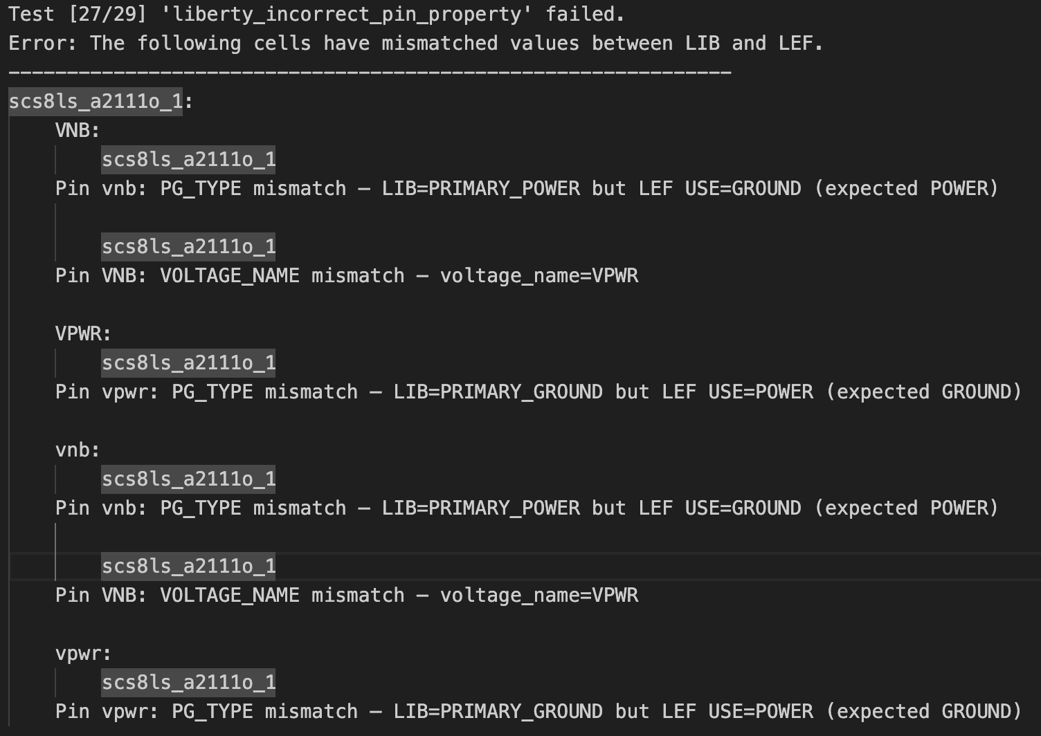
New Implementation Error File
*note: Lib File purposely edited to create errors to test
LEF File
Name
Cell Name
Pin name
Type of mismatch
Details of Mismatch
Current Name

Slide 30
VIA Obstructions
The current script does not ensure that all cell VIAS have OBS layers associated with them.
Script needs to be updated to perform the following:
Identifies VIA definitions within cells in the Pin/Port section.
Verifies that VIAS have associated OBS layers.
The purpose for VIA OBS checking is to help prevent routing conflicts during physical design.

Slide 31
VIA Obstructions
Updated the script to perform the following:
Detect Via statements during LEF parsing.
Checks the PIN/PORT section of the cell
Store Via information.
Validate Vias have associated OBS layer.
Does this by checking every layer in the OBS section of the cell
Report error when Via layer is not included.

Slide 32
VIA Obstructions TLEF file
LAYER
MASTERSLICE
PWELL, NWELL
IMPLANT
VTL_N/P, VTH_N/P
CUT
CO, VIA1-VIA8
ROUTING
MET1-MET8
The script parses all the CUT layers and stores its information.

Slide 33
VIA Obstructions LEF file
1. The script parses all the Pins/Ports to see if there are via layers. If there is, the script saves that via Information.
MACRO
- CLASS / SIZE / SYMMETRY
- PIN Statements
PORT
Layer VIA
VIA Geometry
- OBS
Layer VIA
VIA OBS Geometry
2. The script then goes to OBS section and checks all the layers. If there is no VIAs, the script will report an error. If VIAs exist, it passes the test.

Slide 34
VIA Obstructions Flowchart Part 1
Start
“Warning: NO TLEF Found”
No
Is TLEF file provided
Yes
Parse TLEF
Extract all Cut layers
Use predefined layers
Parse LEF File
Next Slide

Slide 35
VIA Obstructions Flowchart Part 2
Previous Slide
Cut Layers Found?
No
“Passes Via OBS checking test”
For each Layer in Pin/Port
Yes
Cut Layers in OBS?
Is Layer a Cut Layer?
No
“Error: Cut Layer missing from OBS”
No
Yes
Yes
Skip
Store Pin and Layer Name
“Passes Via OBS checking test”
End

Slide 36
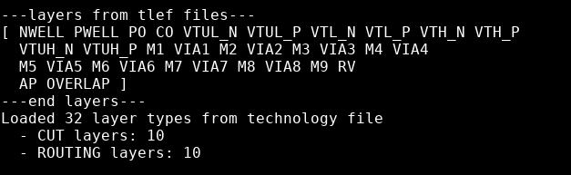

VIA Obstructions Output Part 1
Tested the script with provided LEF and TLEF files.
Output:
Outputs all layers collected
Number of Cut
And Routing layers
Failed the Via OBS checking.
Added the error to the error log file.

Slide 37
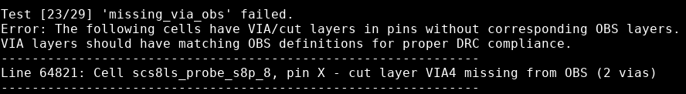
VIA Obstructions Output Part 2
The output from LEF error log file:
Reason why it failed the test
Error line number
Cell name Pin name Layer name Number of Vias in that layer

Slide 38
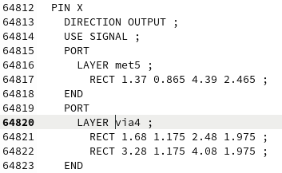
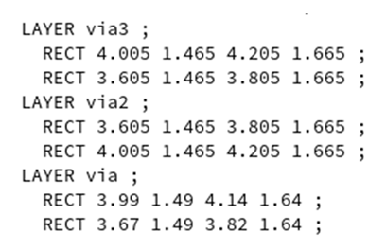
VIA Obstructions Output Part 3
Pin X from the LEF file:
2. We can see that VIA 4 does not have an
associated layer in OBS section.
1. Checking if VIA4 has an
associated OBS layer

Slide 39
Code Readability
Encapsulation:
Problem: The original script used global file handling and manual line tracking, making it fragile and hard to debug.
Solution: Implemented the FileCursor class. This object-oriented approach encapsulates the file reading logic, keeping the current line and index safe and consistent.
Modularization:
Problem: The logic for parsing files and comparing them was mixed into one massive procedural block.
Solution: Extracted distinct responsibilities into named methods like parse_lef_files, parse_lib_files, and compare_lef_lib.
Safe Resource Management:
Problem: Files were opened manually and risked remaining open if the script crashed.
Solution: Converted file operations to use Ruby's block syntax (File.open(...) do |file|), ensuring all files close automatically even if errors occur.

Slide 40
# | TODO Description | Status | Notes
1 | Wrap file/index in PBR_Int | ✅ DONE | Replaced with object-oriented FileCursor class
2 | Collect get_current_line methods | ✅ DONE | Replaced with object-oriented FileCursor class
3 | WS DIR Parsing needs method | ✅ DONE | Logic extracted into modular functions to parse_ws_dir.
4 | LEF Parsing needs method | ✅ DONE | Logic extracted into modular functions to parse_lef_files.
5 | Lib Parsing needs method | ✅ DONE | Logic extracted into modular functions to parse_lib_files.
6 | LEF-LIB Compare needs method | ✅ DONE | Logic extracted into modular functions to compare_lef_lib.
7 | Print file needs method | ✅ DONE | Logic extracted into modular functions to print_output_files.
8 | Use block format for File.open | ✅ DONE | Implemented in print_output_files. Implemented block syntax to auto-close files.
9 | Cell properties: case vs if/else | ✅ DONE | Refactored Cell to use case.
10 | Cell print: Writing to file inadvisable | ✅ DONE | Refactored to to_s.
11 | Layer checks: Make TLEF required | ✅ DONE | TLEF parser now correctly extracts CUT/ROUTING layers.

Slide 41
# | TODO Description | Status | Notes
12 | Lib parsing: area/pins/direction | ✅ DONE | Parses completed and all cells, pins and properties parsed properly
13 | PG_PIN check (PWR/GND) | ✅ DONE | Implemented in LibRuleChecker class
14 | Pin Init: Should not do work | ✅ DONE | Logic moved to new parse() method.
15 | Uncommon properties: Deprecate | ✅ DONE | Function deleted and calls removed.
16 | Collect rules in LibRuleChecker | ✅ DONE | Moved to LibRuleChecker class
17 | Errors: Print file-to-file | ❌ NOT DONE | Still prints large block output (Low priority).
18 | Cell Sort: Should be private | ✅ DONE | sort! is now private and automatic.
19 | Cell Source: SOURCE syntax check | ✅ DONE | Logic removed/deprecated during cleanup.
20 | Add missing_source error key | ✅ DONE | Logic removed/deprecated during cleanup.
21 | Layer Sort: coordSort private | ✅ DONE | sort! is now private and automatic.
22 | Pin Init: Separate function | ✅ DONE | Logic moved to new parse() method.

Slide 42
Refactoring Impact
Before:
Procedural "spaghetti code."
Global variables for file tracking.
Manual array indexing (e.g., line[index+1]).
After:
Object-Oriented Design: FileCursor and LibRuleChecker classes manage their own data.
Scalability: New checks (like the VIA OBS check) were easy to add because the parsing logic is now separate from the checking logic.
Maintainability: Future teams can work on compare_lef_lib without breaking the file reader.

Slide 43
Summary
Improved LEF vs LIB by implementing pin property checks for direction, clock, pg_types and related ground and power references
Added Via Obstruction checking to help prevent routing conflicts during physical design.
Completed by parsing CUT layers from TLEF and PORT sections from LEF, then verifies Via layers exist in OBS sections.
Refactored codebase for maintainability
Transformed a procedural script into an Object-Oriented application by implementing a FileCursor class, modularizing file processing, and resolving over 20 legacy TODO items to reduce technical debt.

Slide 44
Possible Future Work
Set up CONFIG file
The goal is to move options from command-line flags to a more permanent configuration file.
Investigate SOURCE USER
Figure out what to do with the SOURCE property which are still in the Cell class.
Research SI2 LEF/DEF APIs
This is a research task to see if an external API would be better than this custom script.
Update Flowchart
Need to update flowchart for the changes made in TLEF/TF parsing , LEF vs LIB, LEF parsing for VIAs, and checking of VIAs in OBS.
Modular File Architecture
Current State: The ruby file is currently a single "monolithic" script holding all logic (parsing, data models, comparison, and reporting).
Proposed Change: Split the script into a standard library structure:
lib/parsers/: Separate files for FileCursor, TLEF_File, and Liberty_Cell.
lib/models/: Separate files for Cell, Pin, and Layer.
lib/reporters/: Logic for printing errors and sorted files.
Benefit: Allows multiple developers to work on various parts of the tool simultaneously without merge conflicts.

Slide 45
Backup Slides For The Rest
Acquired From Previous Team (S22)

Slide 46
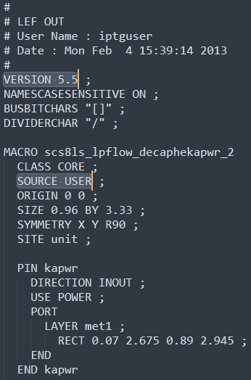
Possible Future Work - SOURCE USER Syntax
scs8ls_lpflow_s8p.lef
LEF/DEF syntax v5.5
Each macro specifies a SOURCE property
LEF/DEF language reference v5.7, v5.8
SOURCE property not part of LEF syntax
Only part of DEF syntax
DEF Syntax:
SOURCE specifies source of component
USER specifies component is generated by user
LEF QA Script
Includes SOURCE as one of the possible LEF syntax keywords
Doesn’t throw errors when SOURCE is included in LEF files
Need to do further research and determine scope of this problem

Slide 47
Possible Future Work - SI² LEF/DEF APIs
Silicon Integration Initiative (SI²)
Formerly CAD Framework Initiative (CFI)
Non-profit consortium of semiconductor, systems, EDA, and manufacturing companies
https://si2.org/
Distributes LEF/DEF APIs in C/C++
LEF/DEF APIs
Created and updated by Cadence
Used to read, write, and manipulate LEF/DEF files
APIs can parse all LEF syntax keywords
Need to explore APIs more and determine tradeoffs for adopting

Slide 48
Updated Keyword Discrepancies
Keyword Highlighting:
Only in LEF files
No highlighting - In both script and LEF files
[VERSION statement]
[BUSBITCHARS statement]
[DIVIDERCHAR statement]
[VIA statement] …
[SITE statement]
[MACRO statement] …
[BEGINEXT statement] …
[END LIBRARY]
{LAYER layerName
[EXCEPTPGNET] [SPACING minSpacing | DESIGNRULEWIDTH value] ;
[WIDTH width ;]
{PATH [MASK maskNum] pt ... ;
| PATH [MASK maskNum] ITERATE pt ... stepPattern ;
| RECT [MASK maskNum] pt pt ;
| RECT [MASK maskNum] ITERATE pt pt stepPattern ;
| POLYGON [MASK maskNum] pt pt pt pt ... ;
| POLYGON [MASK maskNum] ITERATE pt pt pt pt ... stepPattern ;
} ...
| VIA [MASK viaMaskNum] pt viaName ;
| VIA ITERATE [MASK viaMaskNum] pt viaName stepPattern ;
} ...
12/19/2025
EE/CPE584 Intro to VLSI
48

Slide 49
Updated Keyword Discrepancies
MACRO macroName
[CLASS
{ COVER [BUMP]
| RING
| BLOCK [BLACKBOX | SOFT]
| PAD [INPUT | OUTPUT |INOUT | POWER | SPACER | AREAIO]
| CORE [FEEDTHRU | TIEHIGH | TIELOW | SPACER | ANTENNACELL | WELLTAP]
| ENDCAP {PRE | POST | TOPLEFT | TOPRIGHT | BOTTOMLEFT | BOTTOMRIGHT}
}
;]
[FIXEDMASK ;]
[FOREIGN foreignCellName [pt [orient]] ;] ...
[ORIGIN pt ;]
[EEQ EEQmacroName ;]
[SIZE width BY height ;]
[SYMMETRY {X | Y | R90} ... ;]
[SITE siteName [sitePattern] ;] ...
[PIN statement] ...
[OBS statement] ...
[DENSITY statement] ...
[PROPERTY propName propVal ;] ...
END macroName
Keyword Highlighting:
Only in LEF files
No highlighting - In both script and LEF files
12/19/2025
EE/CPE584 Intro to VLSI
49

Slide 50
Updated Keyword Discrepancies
Keyword Highlighting:
Only in LEF files
No highlighting - In both script and LEF files
[PIN pinName
[TAPERRULE ruleName ;]
[DIRECTION {INPUT | OUTPUT [TRISTATE] | INOUT | FEEDTHRU} ;]
[USE { SIGNAL | ANALOG | POWER | GROUND | CLOCK } ;]
[NETEXPR "netExprPropName defaultNetName" ;]
[SUPPLYSENSITIVITY powerPinName ;]
[GROUNDSENSITIVITY groundPinName ;]
[SHAPE {ABUTMENT | RING | FEEDTHRU} ;]
[MUSTJOIN pinName ;]
{PORT
[CLASS {NONE | CORE | BUMP} ;]
{layerGeometries} ...
END} ...
[PROPERTY propName propVal ;] ...
[PROPERTY LEF58_VIAINPINONLY “VIAINPINONLY ; ” ;]
[ANTENNAPARTIALMETALAREA value [LAYER layerName] ;] ...
[ANTENNAPARTIALMETALSIDEAREA value [LAYER layerName] ;] ...
[ANTENNAPARTIALCUTAREA value [LAYER layerName] ;] ...
[ANTENNADIFFAREA value [LAYER layerName] ;] ...
[ANTENNAMODEL {OXIDE1 | OXIDE2 | OXIDE3 | OXIDE4} ;] ...
[ANTENNAGATEAREA value [LAYER layerName] ;] ...
[ANTENNAMAXAREACAR value LAYER layerName ;] ...
[ANTENNAMAXSIDEAREACAR value LAYER layerName ;] ...
[ANTENNAMAXCUTCAR value LAYER layerName ;] ...
END pinName]
12/19/2025
EE/CPE584 Intro to VLSI
50

Slide 51
Updated Keyword Discrepancies
Keyword Highlighting:
Only in LEF files
No highlighting - In both script and LEF files
[OBS
{LAYER layerName
[EXCEPTPGNET]
[SPACING minSpacing | DESIGNRULEWIDTH value] ;
[WIDTH width ;]
{ PATH pt ... ;
| PATH ITERATE pt ... stepPattern ;
| RECT pt pt ;
| RECT ITERATE pt pt stepPattern ;
| POLYGON pt pt pt pt ... ;
| POLYGON ITERATE pt pt pt pt ... stepPattern ;
} ...
| VIA pt viaName ;
| VIA ITERATE pt viaName stepPattern ;
} ...
END]
12/19/2025
EE/CPE584 Intro to VLSI
51

Slide 52
VIA Obstructions Fallback Patterns Part 1
Fallback patterns used for Cut and Routing layers:
Cut Pattern | Example
/^VI\d*$/i | VI, VI1, VI2
/^VIA\d*$/i | VIA, VIA1, VIA2
/^V\d+$/i | V1, V2, V12
/^CUT\d*$/i | CUT, CUT1, CUT2
/^CONT$/i | CONT
/^MCON$/i | MCON
/^CONTACT$/i | CONTACT
/^CO$/i | CO
Routing Pattern | Example
/^ME\d+$/i | ME1, ME2, ME12
/^MET\d+$/i | MET1, MET2
/^METAL\d*$/i | METAL, METAL1, METAL2
/^M\d+$/i | M1, M2, M9
/^LI\d*$/i | LI, LI1
/^AP\d*$/i | AP, AP1

Slide 53
VIA Obstructions Fallback Patterns Part 2
The warning comment if no TLEF file is passed:

